Slide 1
n-Queens Problem
From: Design & Analysis of Algorithm
By Anany Levitin

Slide 2
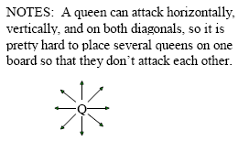
n-Queens Problem
The problem is to place n queens on an n × n chessboard so that no two queens attack each other by being in the same row or in the same column or on the same diagonal.

Slide 3
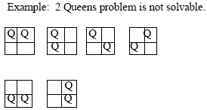
n-Queens Problem
For n = 1, the problem has a trivial solution, and it is easy to see that there is no solution for n = 2 and n = 3.

Slide 4
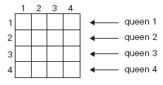
n-Queens Problem
Let us consider the four-queens problem and solve it by the backtracking technique.
Since each of the four queens has to be placed in its own row, all we need to do is to assign a column for each queen on the board presented in following Figure.

Slide 5
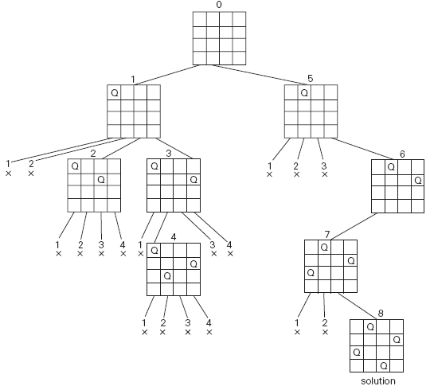
State-space tree of problem by backtracking. X denotes an unsuccessful attempt to place a queen in the indicated column. The numbers above the nodes indicate the order in which the nodes are generated.

